Slide 1
Max Snax App Design
Akshit Gandotra

Slide 2
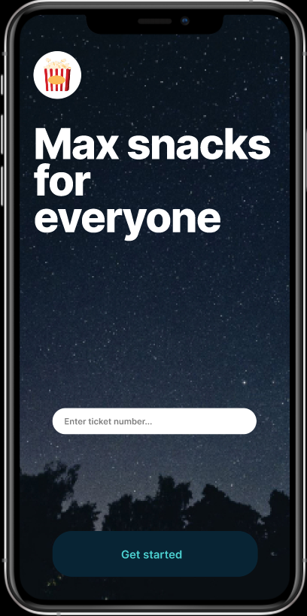
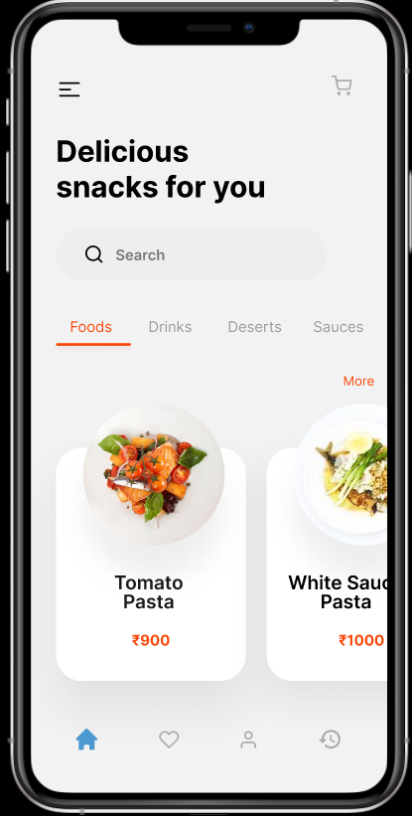
Project overview
The product:
Max Snax is a regional movie theatre located in the suburbs of a metropolitan area. It strives to deliver snacks to provide an enjoyable experience. They offer a wide spectrum of competitive pricing.
Project duration:
August 2022 to September 2022.

Slide 3
Project overview
The problem:
Ordering and Picking snacks during movie
The goal:
Design an app for Max Theatres that allows users to easily order and pick up fresh, healthy dishes.

Slide 4
Project overview
My role:
UX designer designing an app for Max Snax from conception to delivery.
Responsibilities:
Conducting interviews, paper and digital wireframing, low and high-fidelity prototyping, conducting usability studies, accounting for accessibility, and iterating on designs.

Slide 5
Understanding
the user
User research
Personas
Problem statements
User journey maps

Slide 6
User research: summary
I conducted interviews and created empathy maps to understand the users I’m designing for and their needs. A primary user group identified through research was working adults who don’t have time to stand in queues.
This user group confirmed initial assumptions about Max Snax customers, but research also revealed that time was not the only factor limiting users from cooking at home. Other user problems included obligations, interests, or challenges that make it difficult to order snacks.

Slide 7
User research: pain points
1
2
3
Time
Accessibility
IA
Working adults are too busy to stand in queues
Platforms for ordering snacks are not equipped with assistive technologies
Text-heavy menus in apps are often difficult to read and order from

Slide 8
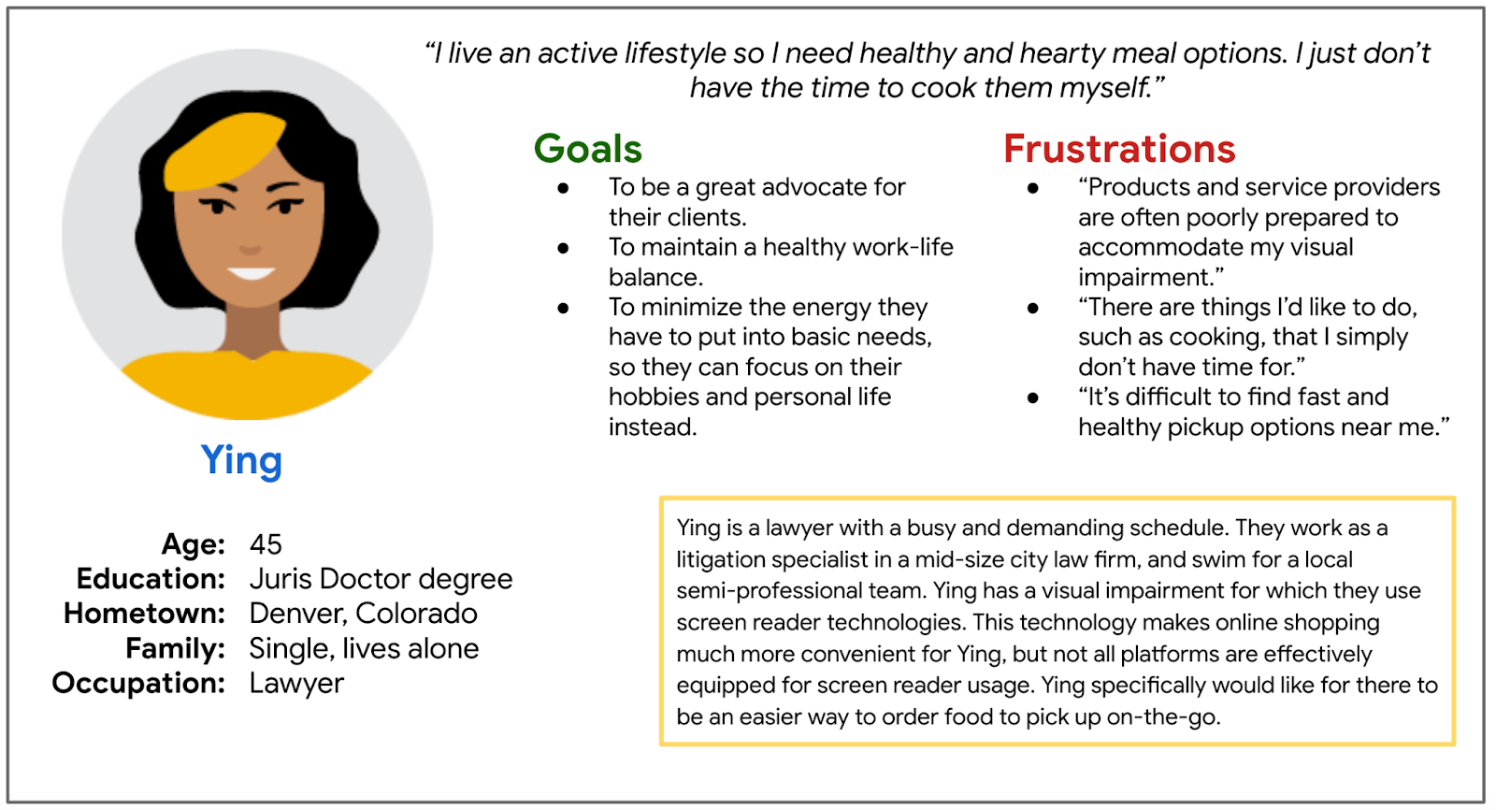
Persona: Priya
Problem statement:
Ying is a busy working adult who needs easy access to healthy food ordering options because they have no time to stand in queues
Priya

Slide 9
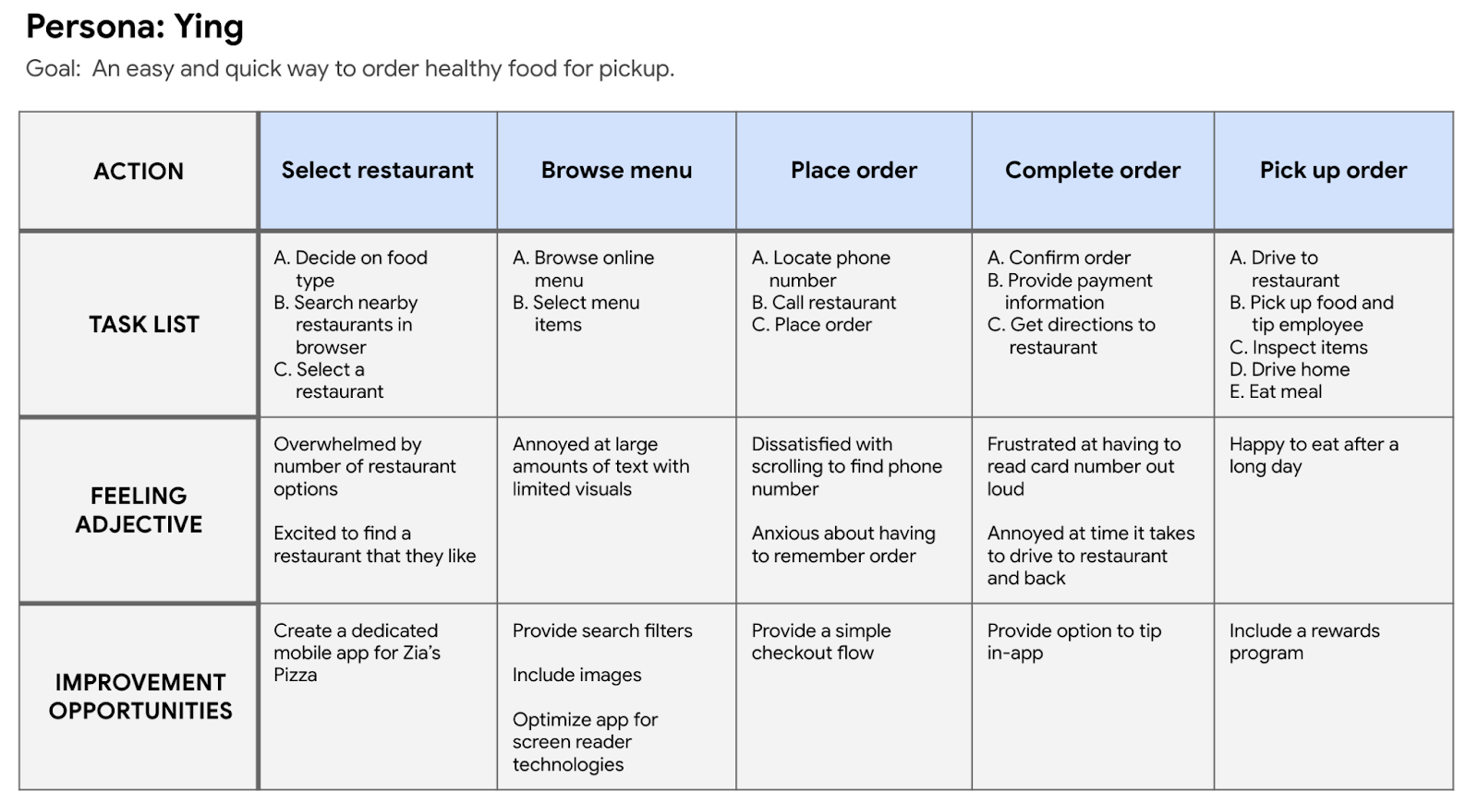
User journey map
Mapping Priya’s user journey revealed how helpful it would be for users to have access to a dedicated snack ordering app.
Priya

Slide 10
Starting
the design
Paper wireframes
Digital wireframes
Low-fidelity prototype
Usability studies

Slide 11
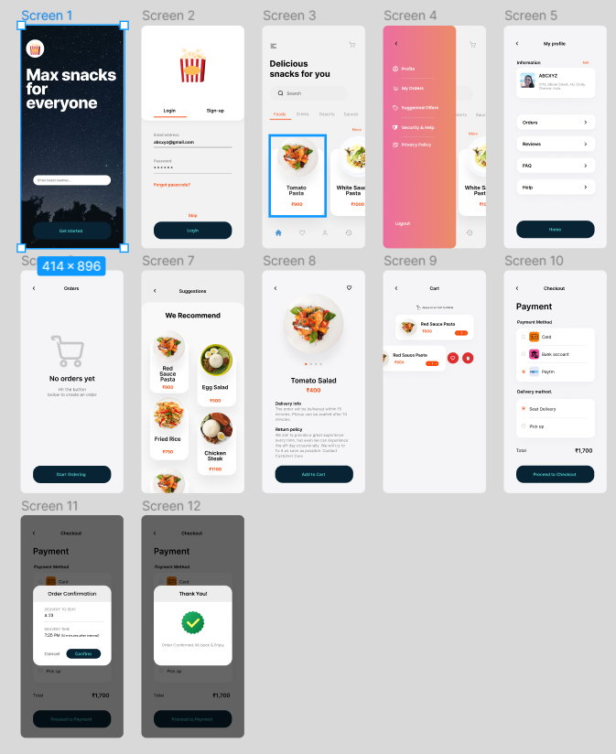
Paper wireframes
Taking the time to draft iterations of each screen of the app on paper ensured that the elements that made it to digital wireframes would be well-suited to address user pain points. For the home screen, I prioritized a quick and easy ordering process to help users save time.

Slide 12
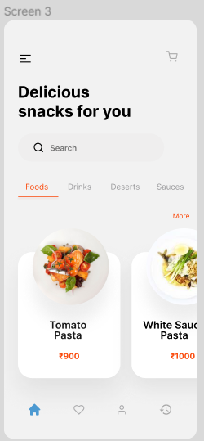
Digital wireframes
This button at the top of the home screen makes it fast and easy for users to see options.
As the initial design phase continued, I made sure to base screen designs on feedback and findings from the user research.

Slide 13
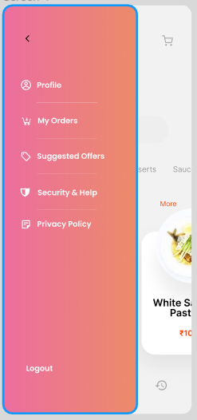
Digital wireframes
Easy access to navigation that’s screen reader friendly.
Easy navigation was a key user need to address in the designs in addition to equipping the app to work with assistive technologies.

Slide 14
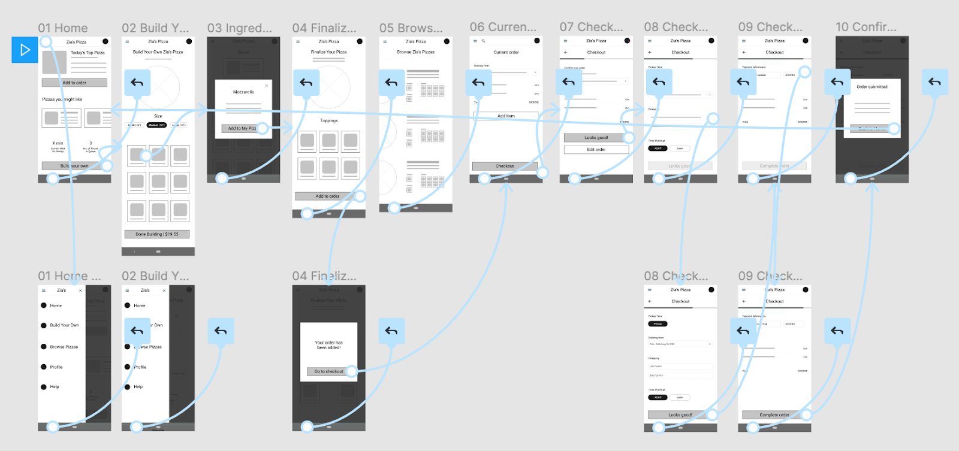
Low-fidelity prototype
Using the completed set of digital wireframes, I created a low-fidelity prototype. The primary user flow I connected was building and ordering a snack, so the prototype could be used in a usability study.

Slide 15
Usability study: findings
I conducted two rounds of usability studies. Findings from the first study helped guide the designs from wireframes to mockups. The second study used a high-fidelity prototype and revealed what aspects of the mockups needed refining.
Round 1 findings
Round 2 findings
1
Users want to order snacks quickly
1
The checkout process has too many unnecessary steps
Users want more customization options
“Build your own” functionality is confusing
2
2
3
Users want a delivery option

Slide 16
Refining
the design
Mockups
High-fidelity prototype
Accessibility

Slide 17
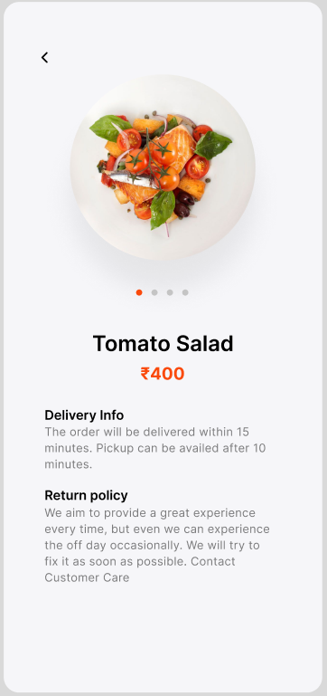
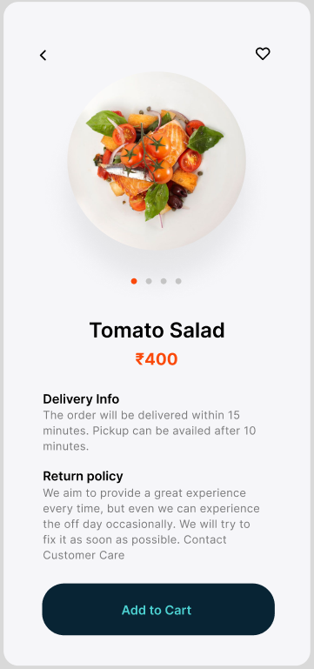
Mockups
Before usability studies
After usability studies
Early designs allowed for some customization, but after the usability studies, I added additional options to choose pizza crust and sauce. I also revised the design so users see all the customization options when they first land on the screen.

Slide 18
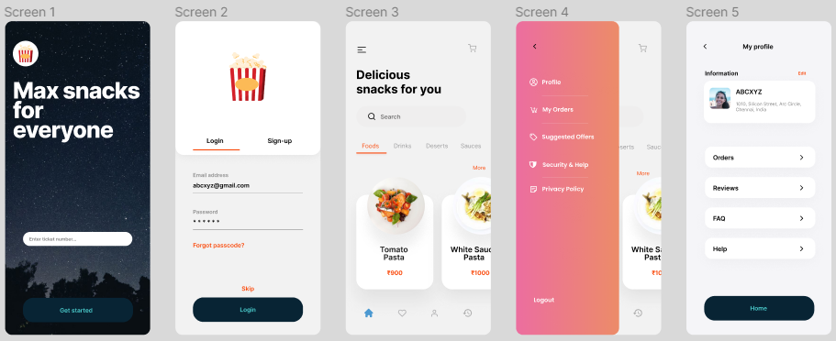
Key mockups

Slide 19
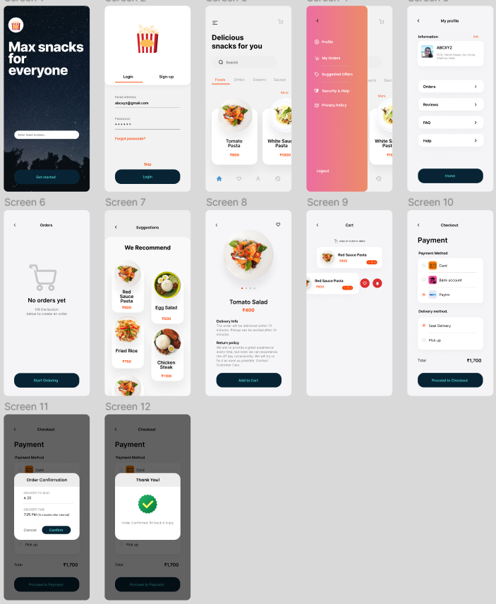
High-fidelity prototype
The final high-fidelity prototype presented cleaner user flows for building a pizza and checkout. It also met user needs for a pickup or delivery option as well as more customization.
View the MAX Snax
https://www.figma.com/file/8nhOCy0qErOhDc3ZVmghDJ/Snack-Ordering-App?node-id=0%3A1

Slide 20
Accessibility considerations
1
2
3
Provided access to users who are vision impaired through adding alt text to images for screen readers.
Used icons to help make navigation easier.
Used detailed imagery for snacks and drinks to help all users better understand the designs.

Slide 21
Going forward
Takeaways
Next steps

Slide 22
Takeaways
Impact:
The app makes users feel like Max Snax really thinks about how to meet their needs.
One quote from peer feedback:
“The app made it so easy and fun to build my own snack! I would definitely use this app as a go-to for a delicious, fast, and even healthy snack.
What I learned:
While designing the Max Snax app, I learned that the first ideas for the app are only the beginning of the process. Usability studies and peer feedback influenced each iteration of the app’s designs.

Slide 23
Next steps
1
2
Conduct another round of usability studies to validate whether the pain points users experienced have been effectively addressed.
Conduct more user research to determine any new areas of need.

Slide 24
Let’s connect!
Thank you for your time reviewing my work on the Zia’s Pizza app! If you’d like to see more or get in touch, my contact information is provided below.
Email: abcxyz@gmail.com
Website: abcxyz.com

Slide 25
Thank you!

